Slide 1
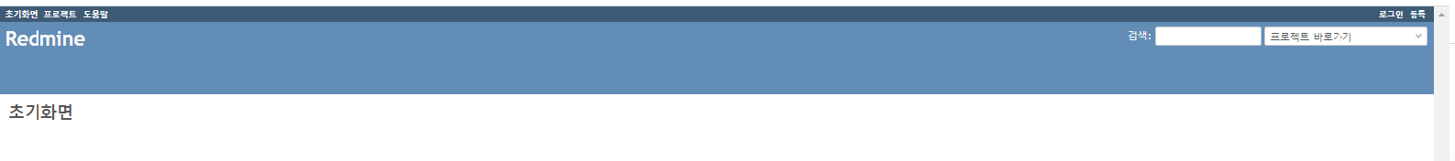
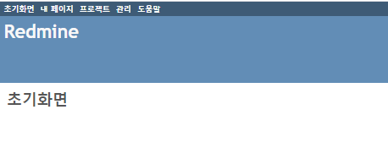
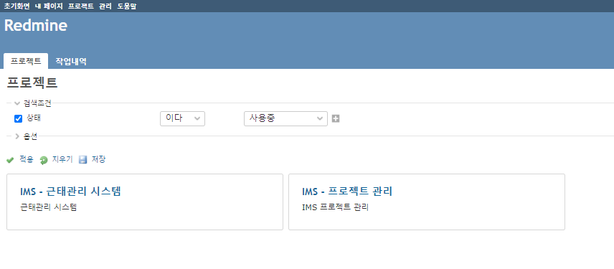
Redmin 접속 ip : http://218.151.225.142:3000/
ID / PASSWORD : admin / infogen!

Slide 2
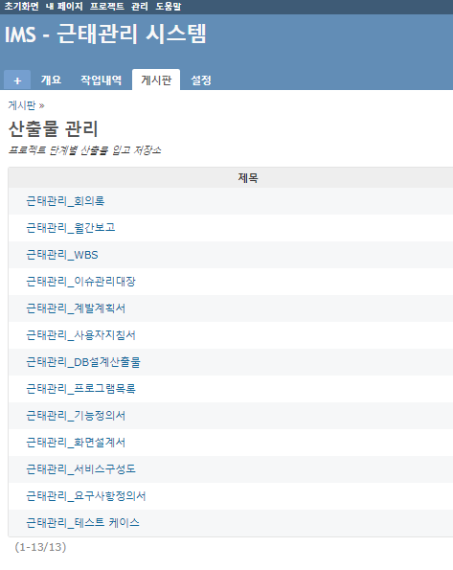
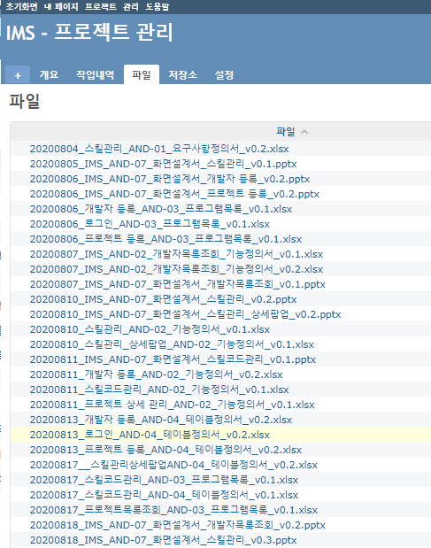

Slide 3
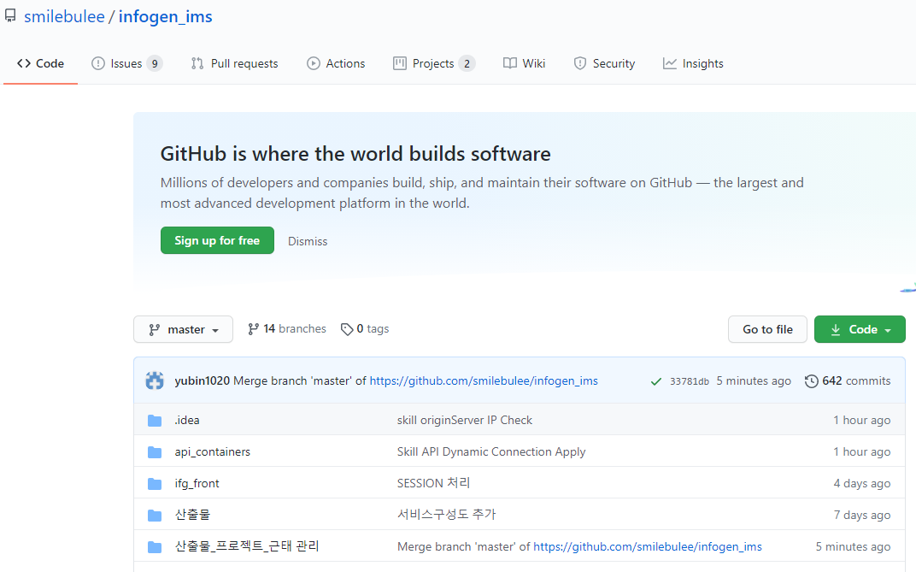
gitHub 접속 IP : https://github.com/smilebulee/infogen_ims

